Slide 1


Manoeuvring Models (Module 4)
Prepared together with Andrew Ross
Dr Tristan Perez
Centre for Complex Dynamic Systems and Control (CDSC)
Professor Thor I Fossen
Department of Engineering Cybernetics

Slide 2
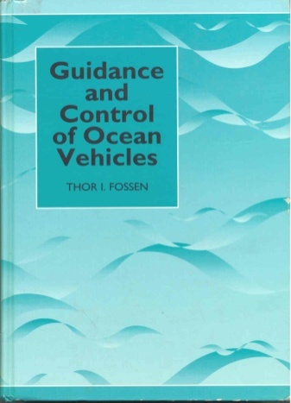
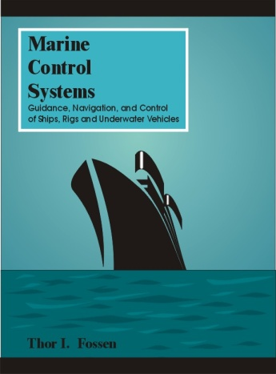
Vectorial Representation for Ships
From robotics to ship modeling (Fossen 1991)
It is here assumed that the hydrodynamic coefficients are frequency independent.
This will be relaxed later!
Consider the classical robot manipulator model:
- q is a vector of joint angles
- is a vector of torque
- M and C are the system inertia and Coriolis matrices
This model structure can be used as foundation to write the 6 DOF marine vessel equations of motion in a compact vectorial setting (Fossen 1994, 2002):
- body velocities:
- position and Euler angles:
M, C and D denote the system inertia, Coriolis and damping matrices
g is a vector of gravitational and buoyancy forces and moments

Slide 3
Rigid-Body Equations of Motion
Newtonian Formulation (Body Frame)
where
M_{RB} rigid-body system inertia matrix
C_{RB} rigid-body Coriolis/centripetal matrix
Rigid-body system inertia matrix
See Fossen (1994, 2002) for parameterizations of C_{RB}
The generalized forces on a floating vessel are superpositioned:
Hydrodynamic radiation-induced forces + viscous damping

Slide 4
Radiation-Induced Hydrodyn. Forces
Forces on the body when the body is forced to oscillate with the wave excitation frequency and there are no incident waves (Faltinsen 1990):
Added mass due to the inertia of the surrounding fluid
Radiation-induced (linear) potential damping due to the energy carried away by generated surface waves
Restoring forces due to Archimedes (weight and buoyancy)
Faltinsen (1990). Sea Loads on Ships and Offshore Structures, Cambridge.
“hydrodynamic mass-damper-spring”

Slide 5
Added Mass and Inertia
Fluid Kinetic Energy
The concept of fluid kinetic energy:
can be used to derive the added mass terms.
Any motion of the vessel will induce a motion in the otherwise stationary fluid. In order to allow the vessel to pass through the fluid, it must move aside and then close behind the vessel.
Consequently, the fluid motion possesses kinetic energy that it would lack otherwise (Lamb 1932).

Slide 6
6 DOF Body-Fixed Representation for Added Mass (Includes Coriolis/Centripetal Terms due to Added Mass)
Kirchhoff's Equations (1869)
kinetic energy due
to the fluid
M_{A}
C_{A}(ν)

Slide 7
Viscous Hydrodynamic Damping
In addition to potential damping we have to include other dissipative viscous terms like skin friction, wave drift damping etc:
Total hydrodynamic damping matrix:
The hydrodynamic forces and moments can be now be written as the sum of :

Slide 8
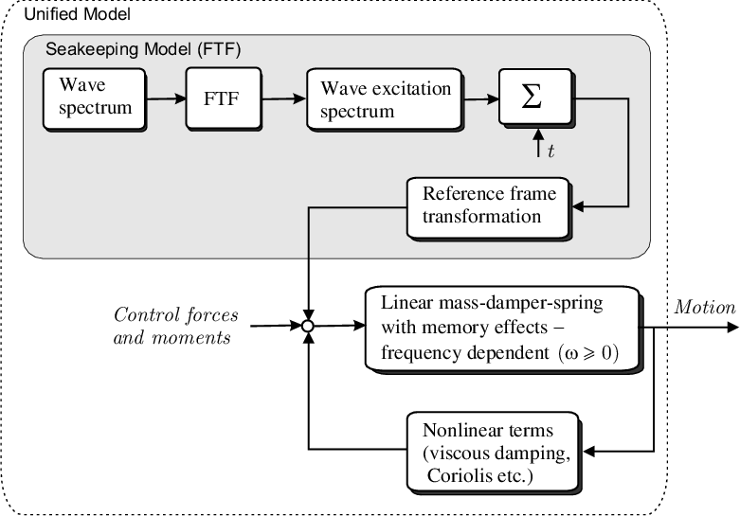
Equations of Motion
The resulting model is (frequency-independent coefficients):
System inertia matrix including added mass
Linear mass-damper-spring
(frequency-independent)

Slide 9
Manoeuvring Hydrodynamics
In classical manoeuvring theory, the forces are modelled at a general non-linear function:
A particular affine parameterization is then used, and the coefficients are estimated linear regression from the data.
The disadvantage of this model representation to a energy-based (Lagrangian) approach is that model reduction, symmetry/skew-symmetry properties, positive matrices, etc. are difficult to exploit in simulation and control design.
This model can, however, be related to the Lagrangian model: as shown by Ross et al. 2007:

Slide 10
Parameterisations
Two types of parameterisations for the hydrodynamic forces are generally used in classical manoeuvring theory:
Truncated Taylor-series expansions:
Davison and Shiff (1946): 1st-order (linear) terms.
Abkowitz (1964): odd terms up to 3rd order.
2nd -order modulus
Fedyaevsky and Sobolev (1963)
Norrbin (1970)

Slide 11
Parameterisations
2nd -order modulus
Taylor-series

Slide 12
Parameterisations
As commented by Clarke (2003),
Taylor expansions give rise to a smooth representation of the forces, but have no physical meaning.
2^{nd-}order modulus expansions represent well the hydrodynamic forces at angles of incidence: cross-flow drag.

Slide 13
Taylor-Series Expansions
Where the partial derivatives are taken at an equilibrium:

Slide 14
Model of Abkowitz (1964)
The coefficients are called hydrodynamic derivatives.
Many terms are set to zero by exploiting physically properties. If not, there will thousands of coefficients.

Slide 15
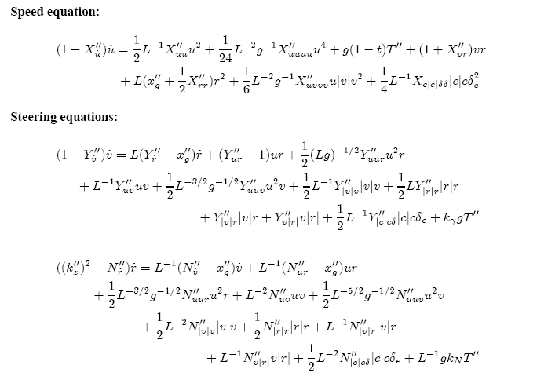
Model of Norrbin (1970)

Slide 16
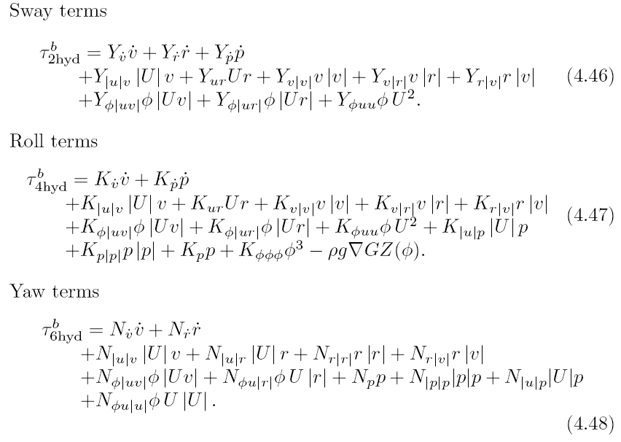
2nd-Order Modulus
From Blanke and Christiansen (1986):

Slide 17
Measurement of Hydrodynamic Derivatives
PMM
Experiments with model tests.
Full scale sea trials and system identification.
Theoretical prediction methods.
Regression analysis results from similar designs.
Model tests that can be performed
Straight line in a towing tank,
Rotating arm,
Planar motion mechanism PMM,
Oscillator tests,
Free running (radio controlled).

Slide 18
Experimental Methods
Model testing in Peerlesspool in London

Slide 19
Measurement of Hydrodynamic Derivatives
Rotating arm

Slide 20
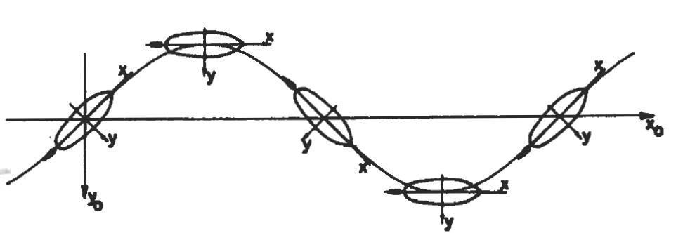
Typical Tests
Pure Sway:
Pure yaw:
Drift and yaw:
Different tests are used to fit different parts of the model.

Slide 21
Measurement of Hydrodynamic Derivatives
During the model tests, the model is forces to move and forces velocities and accelerations are recorded.
Then the hydrodynamic derivatives are estimated from regression analysis.

Slide 22
A Novel 4 DOF Manoeuvring Model
Ross et. al. (2007) has reassessed the manoeuvring models in the literature, and formulated a novel 4 DOF (surge, sway, roll, yaw) Lagrangian model using first principles and superposition of:
Potential (added mass)
Circulation effects: lift and drag
Effect of roll on circulation effects
Cross-flow drag.
The advantage of the Lagrangian model is its vector representation which is tailor made for energy-based control design (Lyapunov).

Slide 23

Added Mass and Coriollis
The 4 DOF solution of Kirchhoff’s equations can be expressed as (Fossen, 2002)
Added mass
Added mass Coriollis and Centripetal terms

Slide 24
Model of Ross et al. (2007)
Circulation effects (lift and drag), effect of roll on circulation effects and cross-flow drag (modulus representation) are derived in Ross et al. (2007):
where the components are:

Slide 25
Manoeuvring Model
Combining all the terms in a matrix for, we obtain the manoeuvring equations in Lagrangian form (Fossen 1994, 2002).

Slide 26
Model Validation with PMM Data
To validate the model, Ross et al. (2007) used data of several PMM tests, and perform a regression based on the model structure derived.
Then compared the fit with that of a model fitted by a tank testing facility to the same dataset.

Slide 27
Fitting Using PMM Data @ 30kt

Slide 28
Validation in Full Scale (Perez et al.,2007)
Perez et al. (2007) fitted a simplified model to data recorded on full scale manoeuvres of Austal’s Trimaran Hull 260.
The parameters were fitted with data of a 20-20 zig-zag test, and then the model validated with data of a 10-10 zig-zag test.

Slide 29
Simplified Model
The model was simplified according to the that of Blanke (1981). This was done because the excitation signal was not rich enough to estimate all the parameters—the zig-zag test is not designed for system identification!

Slide 30
Model Fitting (20-20 ZZ)

Slide 31
Model Validation (10-10 ZZ)

Slide 32
Effects of Currents
In some applications, where positioning is important, the effects of current must be considered:
The current has to effects, which are represented with the velocity of the vessel relative to the current velocity:
Potential: The Munk moment is incorporated in the added mass Coriollis-Centripetal terms.
Viscous: eddy making and skin friction. These are incorporated in the cross-flow drag.

Slide 33
References
Davidson, K. S. M. and L. I. Schiff (1946). “Turning and Course Keeping Qualities.” Transactions of SNAME.
Abkowitz, M. A. (1964). “Lectures on Ship Hydrodynamics - Steering and Manoeuvrability.” Technical Report Hy-5. Hydro- and Aerodynamic Laboratory. Lyngby, Denmark.
Fedayevsky, K.K. and G.V. Sobolev (1963). “Control and Stability in Ship Design.” State Union Shipbuilding Publishing House. Leningrad, USSR.
Norrbin, N. (1971). “Theory and observations on the use of a mathematical model for ship manoeuvring in deep and conned water.” Technical Report 63.Swedish State Shipbuilding Experimental Tank. Gothenburg.
Clarke, D. (2003). “The foundations of steering and manoeuvring.” In: Proceedings of the IFAC Conference on Control Applications. Plenary talk.
Ross, A., T. Perez, and T. Fossen (2007) "A Novel Manoeuvring Model based on Low-aspect-ratio Lift Theory and Lagrangian Mechanics." IFAC Conference on Control Applications in Marine Systems (CAMS). Bol, Croatia, Sept.
Blanke, M. (1981). Ship Propulsion Losses Related to Automated Steering and Prime Mover Control. PhD thesis. The Technical University of Denmark, Lyngby.
Christensen, A. and M. Blanke (1986). A Linearized State-Space Model in Steering and Roll of a High-Speed Container Ship. Technical Report 86-D-574.Servolaboratoriet, Technical University of Denmark. Denmark.
Perez,T., T, Mak, T. Armstrong, A.Ross, T. I. Fossen (2007) “Validation of a 4DOF Manoeuvring Model of a High-speed Vehicle-Passenger Trimaran." In Proc. 9th International conference on Fast Transportation. Shanghai, China Sept.

